Slide 1
Integrated Relaxation Pressure Classification and Probe Positioning Failure Detection in High-Resolution Esophageal Manometry Using Machine Learning
2021 Dec 30
鄧仲恩
NTUST GAMELab

Slide 2
Outline
Introduction
Methods
Results
Discussion
NTUST GAMELab

Slide 3
Introduction
NTUST GAMELab

Slide 4
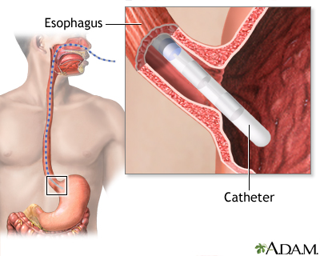
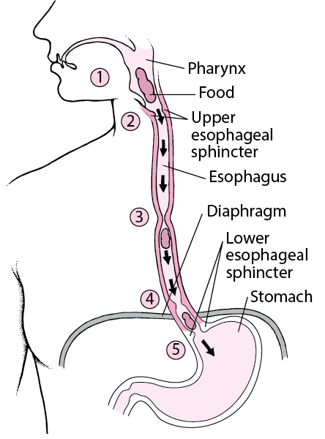
Introduction
Problem
difficulty swallowing
gastric reflux
-> esophageal motility disorders (EMD)
Techniques
Esophagogastroduodenoscopy (上消化道內視鏡)
pH monitoring
esophageal manometry
36
NTUST GAMELab
Notes:
圖片連結 https://www.msdmanuals.com/-/media/manual/home/images/g/i/h/gi-how-the-esophagus-works-v2.gif?thn=0&sc_lang=en

Slide 5
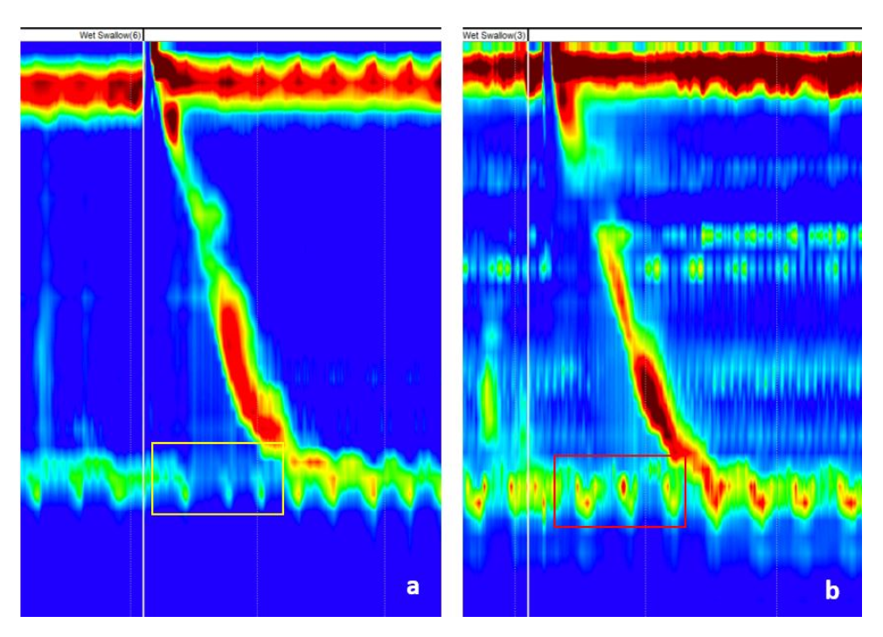
Introduction
According to the Chicago Classification algorithm, the integrated relaxation pressure (IRP) is the first parameter to differentiates between disorders of esophago-gastric junction outflow and peristalsis.
IRP measures the “opening” of the LES during swallowing.
High IRP -> esophago-gastric junction outflow Normal IRP -> peristalsis
detecting catheter positioning failure.
LES
4S
Normal IRP
High IRP
NTUST GAMELab
Notes:
４.增加ＥＭＤ的precision

Slide 6
Methods
NTUST GAMELab

Slide 7
Methods - Data Analysis
Our database (October 2014–February 2021).
Half of the patients had achalasia(食道弛緩不能).
At least 6 h of fasting.
Using the ISOLAB manometry system and a solid-state catheter with 36 sensors.
At least 3 sensors in the stomach.
10 wet 5 mL swallows, spaced at more than 30 s.
Patient in the supine position and the thorax angulated at 30◦.
The upper normal limit of IRP, was set at 28 mmHg.
The datasets were prepared and labeled by two experts.
NTUST GAMELab
Notes:
2 Our center is a reference center for diagnosing achalasia

Slide 8
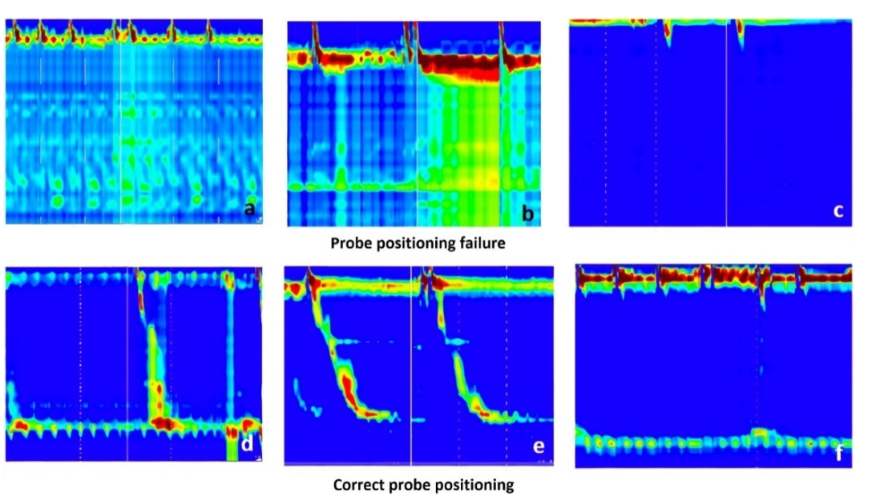
Methods - Data Analysis (First Dataset)
2437 raw images . 67 probe positioning failure and 2370 correct probe positioning.
48.5 ± 16.3 years old
55% were male
NTUST GAMELab
Notes:
LES不清楚，有很多高壓力的地方，鏡像
during a swallow with pressurization ，鏡像
LES is not visible at all.
In the lower images (d–f), the LES is clearly visible (as a green-yellow line in the lower part of the image, determined by the pressure of the LES), and below LES there is a blue band, suggesting that some sensors are in the stomach (the gastric pressure is the reference for manometric measurements).

Slide 9
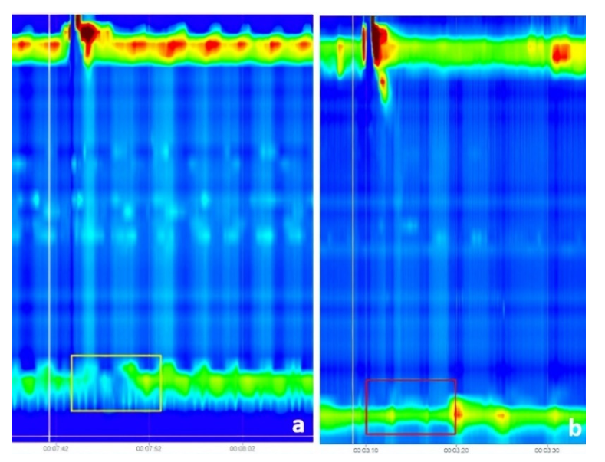
Methods - Data Analysis (Second Dataset)
1079 images, 140 were representing normal IRP and 939 were representing IRP higher than the cut-off.
50.3±17.5 years old.
52.3% were males.
Train contained 70% of the data (657 swallows with high IRP, 98 swallows with normal IRP)。
Test contained 15% of the data (140 swallows with high IRP, and 21 swallows with normal IRP)。
Validation contained 15% of the data 。
Normal IRP
High IRP
NTUST GAMELab

Slide 10
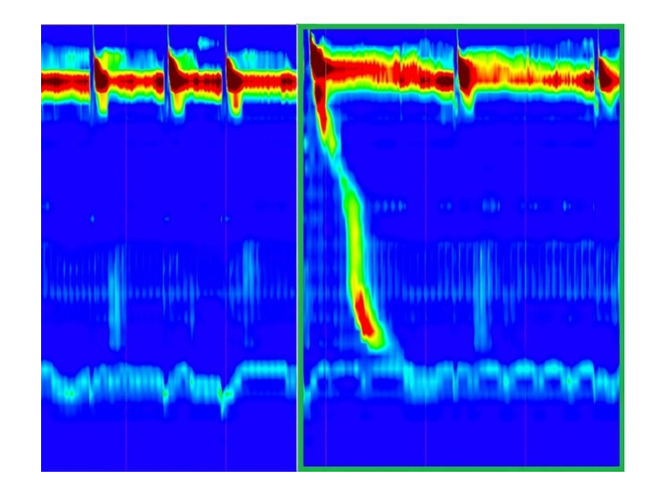
Methods - data preprocessing
ROI
20~30s
NTUST GAMELab

Slide 11
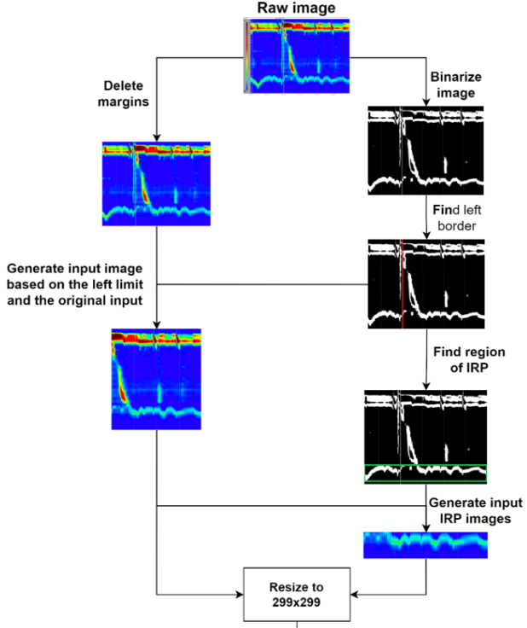
Methods - data preprocessing
histogram of white pixels and selected the maximum pixel count.
First white pixel In a bottom-up direction.
Cropped the image with 100-pixel height.
Resize.
Normalized to [-1,1].
NTUST GAMELab

Slide 12
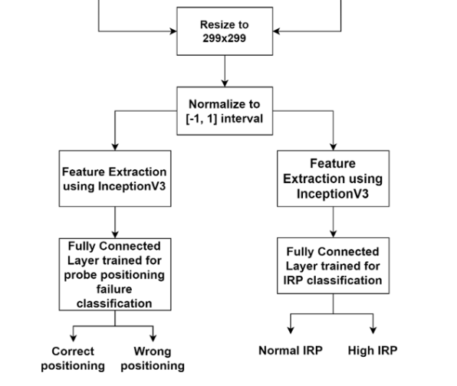
Methods – Transfer Learning
We used the InceptionV3 CNN model which was pre-trained on the ImageNet dataset.
ImageNet dataset contains approximately 1 million images and 1000 classes.
NTUST GAMELab
Notes:
資料量少

Slide 13
Results
NTUST GAMELab

Slide 14
報告完畢 THE END
謝謝 Thank You
NTUST GAMELab

